Slide 1

Balloon pop!
Air is pumped out of the jar and the balloon gets bigger.
The drawing pins will pop the balloon.
Drawing pin
Pop
Balloon grows
Air pumped out

Slide 2
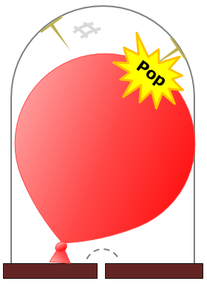
Balloon pop!
Predict
What do you think you will hear when the balloon pops?
Explain
Explain why you think you will hear this.

Slide 3
Balloon pop!
Now watch (and listen) to the demonstration
Observe
Describe what you hear when the balloon pops.
Explain
Were your prediction and explanation correct?
If not, can you explain what you observed?

